Slide 1
Prevention of Occupational Health
Dr. Reshma Reghu,
Lecturer,
Dept. Of Community Medicine

Slide 16
12. Statistical Monitoring Review at several intervals of collected data on health & environmental exposure of occupational groups. The objective is to evaluate the adequacy of preventive measures and occupational health. 13. Research Study to provide a better understanding of the industrial health problems.

Slide 18
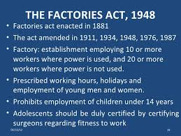

Slide 19
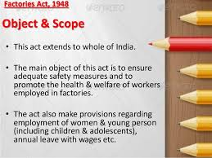

Slide 20
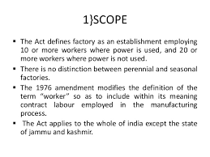

Slide 21
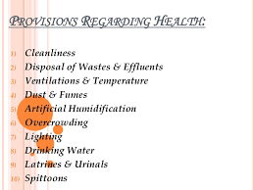

Slide 23
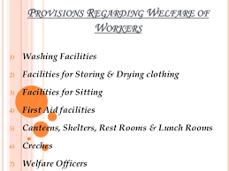

Slide 24
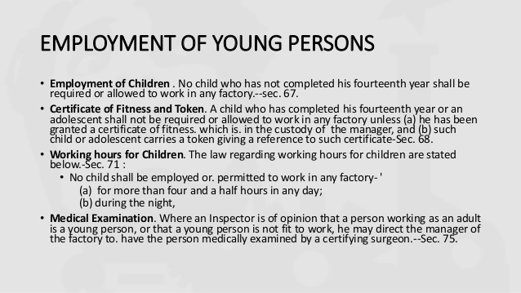

Slide 27
OCCUPATIONAL DISEASE
Information regarding specified accidents which cause death, serious bodily injuries or occupational diseases.
Act gives a schedule of notifiable dieases.
Provision has been made in the 1976 amendment for safety and occupational health surveys in factories and industries.

